Slide 1
DDCA The Australian Council of Deans and Directors of Creative Arts
2019 Leadership Forum and Tertiary Leaders Round Table
30 October 2019
Sponsored by

Slide 2
Beyond Research: Creative Arts in an Impact & Engagement Environment
DDCA conference, Melbourne
Professor Paul Gough RMIT
October 2019

Slide 3
Impact and its causes…

Slide 4
Lessons from the pilot
Universities with strong ERA records in a particular field of research did not necessarily do well in the corresponding impact/engagement pilot – and visa versa; some Universities with ERA2 did very well in the impact pilot, scoring ‘mature’ (3/3).
This suggests that researchers who are good at producing ‘research excellence’ might be different to those who are good at producing ‘research engagement/impact’ ?
Impact upon ‘society’ is often an aggregate of many disciplines’ research, across many interventions, and it is difficult to apportion. Therefore, an alternative approach that is less discipline-based and more based upon the institutional support that Universities provide to facilitate impact and engagement might be a promising direction for this issue to take?

Slide 5
Lessons from the pilot
Appears to be based strongly upon research income, which is very skewed across disciplines. Despite attempts to benchmark by discipline, this leaves many sources of bias in estimates of engagement.
End users are poorly defined. Do they include the general public? If so in what capacity?
An expectation that any metrics for engagement must be drawn from sources of data that are already collected routinely and reliably and that they cannot be ‘gamed’ easily.
In-kind – at least in ARC Linkage grants – seems to fit these requirements, and should perhaps be included?
Why isn’t the role of practice & research in ‘shifting’ culture included? (It is in the UK REF)

Slide 7
National Report on Research Outputs Outcomes and National Report on Impact Case Studies (ARC)

Slide 8
Lessons in engagement from HASS –
18 LAW; 20 Language; Communication and culture
Working with Policy Makers and Public Interest Groups to influence policy
Involvement in developing / reviewing policy & professional standards
Invitations for industry & governments to provide expert review / advice
Invitations to provide evidence to enquiries. Involvement in international agencies WHO UNICEF UN
Provision of access to specialist databases / repositories
Provision of training for professionals

Slide 9
Low rated engagement narratives
Engagement activities and research not clearly linked or well integrated
Limited evidence of overarching engagement strategy &/or supporting processes
Engagement indicators were comparatively low for the discipline with little explanation
Little to no engagement activity in the reference period
Limited evidence of mutually beneficial engagement

Slide 10
Engagement is embedded in strategic plan
Target the ‘right’ partner
Engagement & impact is linked to staff performance and promotion
Dedicated business units – the ‘front door’
Importance of ARCH linkage, ITRP and CRCs
High rated engagement narratives ¹
STEM 06 & 09 HASS 18 & 20

Slide 11
Staff on advisory boards, committees (University ← -> industry)
Consultancies. Specialist, end-user focused conferences, workshops
Multi-media platforms
Co-supervision and mentoring of HDRs
Engagement with schools & educators
High rated engagement narratives ²
STEM 06 & 09 HASS 18 & 20

Slide 12
Lessons:
low rated approach to impact
Impact is driven by individuals [not the university]
Little evidence presented on university’s role
University support is merely considered to be business as usual
University support is not considered to be strategic
Support is not well integrated into the cultures of research, or with the intention of facilitating impact

Slide 13
It’s all about:
Multi-disciplinary Research Centres:; these are important for creating larger research & end-user networks
Formal Partnerships: that can nurture and catalyse relationships and deep collaboration
Strong institutional, administrative and legal support to staff: includes flexibility within staff contracts to support engagement; time, travel, reduced loads
High rated approach to Impact:
Common themes ¹

Slide 14
It’s all about:
Co-location of research facilities
Knowledge transfer experts in-house
Embedded & collocated staff & HDR students
Multi—media platforms
Competitive grants (supporting indirect costs)
High rated approach to Impact:
Common themes ²

Slide 15
Is there a role for ‘research centres’?
A Research Centre can add value because it is:
A title recognised across the sector
A hub for vigorous enquiry where bandwidth is promoted and where the best want to work
A critical mass of people at various stages of their career
A place that can attract funds from a variety of sources
Where changes in key staff do not result in a major loss of focus or quality
Where it is authentic and not just invented for research evaluations!

Slide 16
How does DDCA help build an infastucture of impact and engagement?
How do we gather evidence about the key policy influencers?
How does DDCA share knowledge about state and national networks that might help corroborate our research practices?
What’s our understanding of knowledge exchange and knowledge transfer?
How do we maximise our already strong links with the national and international creative industries?
How do we maximise our already strong links in DDCA themes and disciplines that reach beyond national and international creative industries, into other professions, businesses, industry?

Slide 17
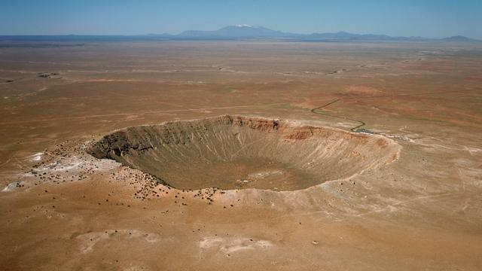
Thank you

Slide 19
A case study approach
Identifying the research;
Interviewing to discuss the impact and engagement activities that have resulted from your research.
Using the Impact Indicators and Engagement Activities document to map the activities
Addressing these questions:

Slide 20
What are the research questions that motivated your research? Can you tell us about the challenges or problems your research sought to address?
Drawing in specific projects can you share with us the social, industry or economic issues or challenges that you feel address your research addresses?
What steps did you take to address these issues? Tell us about the programs of work you undertook?
Who did you work with – beyond academic – to help address these issues? Which partners/stakeholders/end users did you work with, when, and how have they been involved?

Slide 21
To date, what are the major outcomes of the project? Can you see links between the questions and aims that motivated you in your research program and tangible outcomes in how we have shaped policy, society, economy, health and/or the ways in which we understand our world?
What did you do to translate your research work?
Can you tell us about the tangible impact or implications for industry, policy, or society, economy? Can you point to any collaborators – beyond academia – who might provide corroborating evidence for us?
How are and/or could these findings be used?
What ‘evidence’ do you have about your/the project’s research impact? What support would you need in gathering such a body of material by way of corroboration or ‘evidence’?

Slide 22
