Slide 1
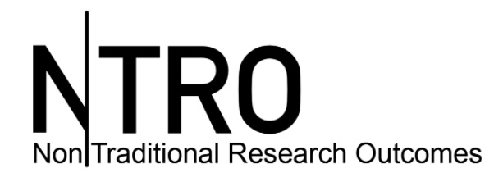
The Australian Council of Deans and Directors of Creative Arts and

Slide 2
Australian Council of Deans and Directors of Creative Arts (DDCA)
“to advance the culture of scholarship in the creative arts higher education sector, offer strong leadership and advocacy for strategic development and advocate more broadly for the role of the creative arts in society”
Members: University creative arts faculties/ schools; independent tertiary arts organisations; peak bodies

Slide 3
Advocacy
ARC ERA 2018 journal review (2017)
ARC Engagement and Impact Assessment Consultation (2016)
Securing Australia’s Future - Research training system review by the Australian Council of Learned Academies ( ACOLA) (2015)
Review of Research Policy and funding arrangements (2015)

Slide 4
Advocacy
Coverage in Media, conferences & journals
DDCA conferences and symposia
Inaugural Conference (Melbourne) 2014
Annual Conference (Adelaide) 2015
The Outstanding Field: Artistic Research Emerging from the Academy (Melbourne) 2015
Students In Creative Arts Research (Newcastle) 2016
Beyond Research: Creative arts in the impact, engagement and innovation agenda. (Melbourne) 22 September 2017.

Slide 5
NiTRO
“a platform for creative artists practicing in academia to contribute to informed discussion about issues and activities relating to practice, research and teaching”
Launched 30 June 2016
97 contributors - creative arts staff domestic and international; media commentators, VCs, DVCs
numerous news items and event details; and a special feature on exhibitions, shows, screenings and ‘happenings’ taking place across the Australian tertiary arts sector.

Slide 6
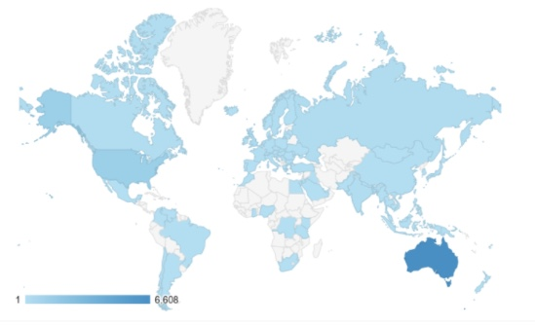
NiTRO – Global readership

Slide 7
Readership
Online readers
7,670 users
22,413 page views
Registered Readers
Nearly 400 – majority fulltime academic staff
73% active arts practitioners
Just over 10 % students

Slide 8
Shaping DDCA and NiTRO
DDCA Board 8 members (plus 2 co-opted & 2 ex-officio)
Su Baker (Melbourne), President
Kim Vincs (Swinburne), Secretary
Marie Sierra (UNSW),Treasurer
Sarah Miller (Wollongong), Member
59% NiTRO Registered Readers are women*
Notes:
* gender not requested in form; based on search on email name and personal knowledge of reader

Slide 9
NiTRO Contributors (8 editions)

Slide 10
Focus and Concerns

Slide 11
Importance of Communicating
“if you want continued government support, it helps if the community. . . understands you do good things for the world” Julie Hare, The Australian (Is There An Artist in the Lab? Edition 1)
“The renewed sense of vigour, and the energetic resistance by those in the arts industries, continue to mobilize arts practitioners, and to strengthen the communities of support” Lynda Hawryluk, AAWP/ SCU (Creative Communication Needs Reciprocal Valuation, Edition 1)
“the creative campus movement is one that makes arts, culture and creativity central rather than incidental to academic life” Deborah Terry, VC Curtin (Creative Community Connections, edition 4)

Slide 12
In our own terms
“There is pressure for curriculum ‘reform’ to prioritise standardisation of courses, with the risk that discipline specific courses will be subsumed by meta courses. Here the loss lies in discipline specific expertise and identity. . .” Lyn Churchill & Jill Franz (Strategic Manoeuvres, Edition 1)
“. . . artistic research has to prove its credentials where criteria of value are still skewed in favor of traditional academic disciplines, whilst beyond the academy, the real prize for the artist is not research grants, but as a contemporary artist in the world of art business. . .” Estelle Barratt & Barbara Bolt (Artistic Research Within the Academy and Beyond, Edition 2)

Slide 13
Against our own measures
“As a sector perhaps we should establish systems for the informed use of econometric methods, tracking contribution to Australia’s economy, as other sectors have explored.” Denise Ferris & Marie Sierra (ATSE’s Research Engagement for Australia May Just Fit Creative Arts, Edition1)
“Most often the data captured is anchored in consumer behaviour – ticket buying, attendance figures, transport costs, food and accommodation – that provides little real evidence of the value or impact of an arts and cultural experience for individuals or communities.” Sandra Gattenhof (Challenging the prevalence of ‘Datastan’ in arts and cultural evaluation, edition 5)

Slide 14
Enhancing student learning
“creative teaching in relation to creative learning that offers new priorities, new narratives, new forms of knowledge, new ways of ‘knowing how to speak’ and ‘knowing how to hear’ for creative teachers, artists and artist scholars” Pamela Burnard (The Imperative of Creative Teaching in Relation to Creative Learning for Artist-Scholars Working in Higher Education, Edition 3)
“The global classroom has fostered transformative learning experiences and global attitudes. . . It has become a true community of practice: a third space for learning where respect and reciprocity is tangible.” Natascha Radclyffe-Thomas (Fashioning the Global Classroom, Edition 6)

Slide 15
And student careers
“. . . it is impossible to ignore the inter-dependence of academia and the arts community. It is clear that academics are not only training students in the craft of percussion performance but also in the way of being a percussionist in the world.” Vanessa Tomlinson (25 World Premiers and 100 compositions, Edition 3)
“This curriculum model engages students in learning activities that are based on participation in the festival or exhibition event, and assessment is aimed at heightening awareness of processes and practices in the Arts . . .” Sue Gillett (Real-World Creative Learning, Edition 3)

Slide 16
Working with our communities
“Aside from developing a field-based methodology to drive their studio practice. . . The Balawan Elective facilitates unique opportunities for students and staff to build relationships and gain first hand understandings with the local Aboriginal community, whilst working alongside Aboriginal artists from the region” Amanda Stuart (The Balawan Elective, Edition 4)

Slide 17
And our arts colleagues outside academia
“I spent a lot of time in the States where artists tend to go back and forth between the professional world and the academic world . . . there are times when it is great to be ‘doing’ and times when it is good to be reflecting and analysing.” Kate Cherry (From Black Swan to NIDA, edition 7)
“. . . practice based research ‘2.0’ . . . is about integrating artform innovation with innovation beyond the artform, so that knowledge generated links not only to other arts practices and to the context of the art world, but seamlessly with other domains, other communities, other industries and other knowledge systems.” Kim Vincs (Directions in Dance Technology Research, Edition 8)

Slide 18
Focusing on artists health
“Self-care is clearly at the top of the agenda. . . .Those in the sector are clearly feeling the stress. . . reporting on the disturbingly high level of suicide attempts in the industry.” Deborah Stone (Supporting Creative Careers, Edition 4)
“There is an opportunity, if not a responsibility, for artists’ unique mental health needs to be met by increased support platforms, whilst embedding practical resilience building strategies in tertiary art curricular” Eileen Siddens (Building Resilience in Visual Artists, edition 3)

Slide 19
Addressing our own challenges
“there is a largely unexamined myth around the extended timeframe allowed in a research project and a correlating improvement in the outcomes of the practice. . .that myth extends to claiming that more time is spent in practice, but in reality . . .more time is spent in thinking about, reading about and researching practice rather than practising” Cheryl Stock (Dancing Elusive Knowledges Across the Research Terrain, Edition 2)
“No researcher wants capital ‘T’ theory to straitjacket. . . Theory does not mean chaining our intellects, but scaffolding our knowledge, allowing us to climb higher” Jeri Kroll (The Creative Arts and New Knowledge – Do We Aim For Questions or Answers?, Edition 2)
“one problem in the discourse in artistic research that such researchers barely quote each other’s projects” Linda Ludwig (Poetry of the Real: Conversations on Arts Research, Edition 3)

Slide 20
Improving our leadership
“. . .a leader will provide scope for. . .variation inside their organisation. It seems vitally important to allow complex ideas and relationships to flourish. And our musician identity provides just such an appreciation of complexity that then lends itself to positive and empathetic leadership” Anna Reid (Musician Identity and Leadership, Edition 7)

Slide 21
and helping the university to do better
“. . we should be leading a vision for the future, because we have the infrastructure to do so. We have the capacity and obligation to lobby. We have staff whose ongoing wage permits them to experiment and take risks in their art, and involve their students in that process. We have to be the model of equitable and sustainable practices.” Cat Hope & Megan Burslem (Paving the way, edition 7)

Slide 22
Where to next?
build our base of contributors and would like to hear more from our sessional and early career academics.
Grow our readership grow particularly within our students
engage our colleagues in the Vocational Education and school sector into the discussion.
“We all know the power of people who are engaged and focused on success in the arts, and the importance of a strong higher education creative arts sector, so please spread the subscription word, help build our base. As always, there is strength in numbers, a unity of purpose and voice and this is true more than ever before.” Su Baker, DDCA President

Slide 23
DDCA and NiTRO
https://www.ddca.edu.au/
https://nitro.edu.au/

